Slide 1
P,NP and NP complete problems
Final Chapter
Part-2

Slide 2
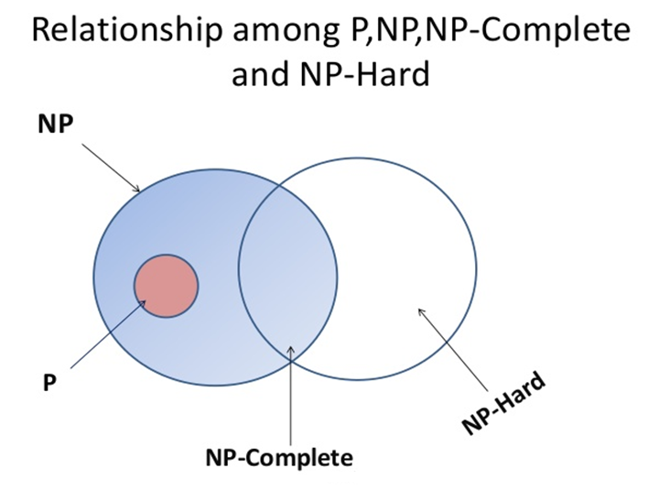

Slide 3
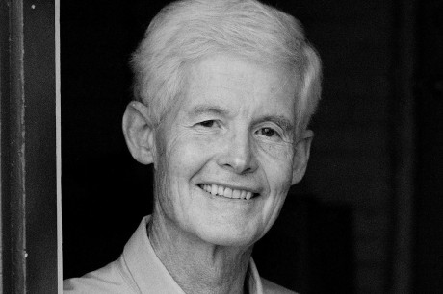

NP Complete: S.A Cooks Theorem
NP-complete problems form a certain important subclass of NP.
The phenomenon of NP-completeness was discovered in the early 1970s by Stephen Cook and Leonid Levin.

Slide 4
Cooks Theorem
If a polynomial time algorithm exists for any of the
NP-complete problems,
all problems in NP would be polynomial time solvable.

Slide 5
Cooks Theorem
To prove that P=NP, it would be sufficient to take any particular NP-complete problem A and show that A∈P.
To prove that P≠NP, it would be sufficient to take any particular NP-complete problem A and show that A∉P.

Slide 6
Cooks Theorem
Cook proved that a particular NP problem known as
SAT( satisfiability of Boolean clause)has the property that, if it is solvable in polynomial time, so as are all NP problems.

Slide 7
Boolean formulas
Boolean variables x,y,… take one of the two values 0 (false) or 1 (true).
Boolean operations: ¬ (NOT), ∧ (AND), ∨ (OR). We write A for ¬A.
Boolean formulas are constructed from variables and operations in the
standard way. Once a truth assignment for variables is given, the
value of a compound formula is calculated as follows:
0 = 1 0 ∧ 0 = 0 0 ∨ 0 = 0
1 = 0 0 ∧ 1 = 0 0 ∨ 1 = 1
1 ∧ 0 = 0 1 ∨ 0 = 1
1 ∧ 1 = 1 1 ∨ 1 = 1
(1 ∧ (0 ∨ 1)) ∨ (0 ∨ 1)
If x=0 and y=1, what is the value
of the following formula?
(y ∧ (x ∨ y)) ∨ (x ∨ y)
(1 ∧ (1 ∨ 0)) ∨ (0 ∨ 0)
(1 ∧ 1 ) ∨ 0
1 ∨ 0
1

Slide 8
The SAT problem
We say that a Boolean formula is satisfiable iff there is an assignment
of 0s and 1s to its variables that makes the formula evaluate to 1.
Are the following formulas satisfiable?
x∧(x∨y)
x∧(x∧y)
SAT = {<φ> | φ is a satisfiable Boolean formula}
SAT ∈ P?
SAT ∈ NP?

Slide 9
NP complete: reduction
Let L1 and L2 are two problems.
L1 reduces to L2 [ Li L2] iff
there is a way to solve L1 by deterministic polynomial time algorithm that solves L2 in polynomial time

Slide 10
NP –complete and NP Hard
Generally
Decision Problems comes under NP –complete
Optimization Problems comes under NP Hard.

Slide 11
Proving NP complete problems

Slide 12
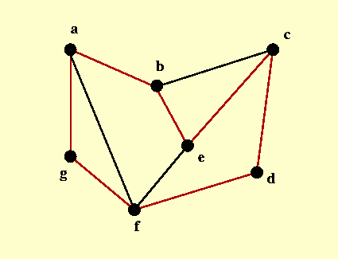
HAMILTONIAN CYCLE
a simple cycle in a graph G that visits each vertex of G exactly once and returns to its starting vertex.

Slide 13
Deterministic algorithms
Algorithm is deterministic if for a given input the output generated is same for a function.
A mathematical function is deterministic. Hence the state is known at every step of the algorithm.

Slide 14
non deterministic algorithms
Algorithm is non deterministic if there are more than one path the algorithm can take.
Due to this, one cannot determine the next state of the machine running the algorithm.
Example would be a random function.

Slide 15
NP problems
Non deterministic machines that can't solve problems in polynomial time are NP. Hence finding a solution to an NP problem is hard but verifying it can be done in polynomial time.

Slide 16
HAMILTONIAN CYCLE is in NP
Let A be some non-deterministic algorithm
Graph G be the input to A.
The vertices of G are numbered from 1 to N.
Call the algorithm A recursively to get the sequence S.
S contains all the vertices without any repetition.
The sequence must start and end at the same vertex.
This check must be made on S in polynomial time n.
If there is a Hamiltonian cycle in G it will output “Y “
Based on the non-deterministic algorithm we are finding the solution
Hence it is in NP

Slide 17
To prove DHC TSP
If there are two problems A and B. to prove B is in NP complete then
Pickup a known NP complete problem A
Reduce A to B.
Map instances of A to B in such a way that if YES for B = YES for A
Prove that this transformation runs in polynomial time.
This proves that B is also NP complete
If there is no Hamiltonian cycle in Graph which represent TSP, that means
TSP is also NP complete.

Slide 18
Cooks Theorem
The satisfiability problem is NP complete

Slide 19
Vertex cover problem

Slide 20
Approximation algorithms for NPC problems
If a problem is NP-complete, there is very likely no polynomial-time algorithm to find an optimal solution
The idea of approximation algorithms is to develop polynomial-time algorithms to find a near optimal solution

Slide 21
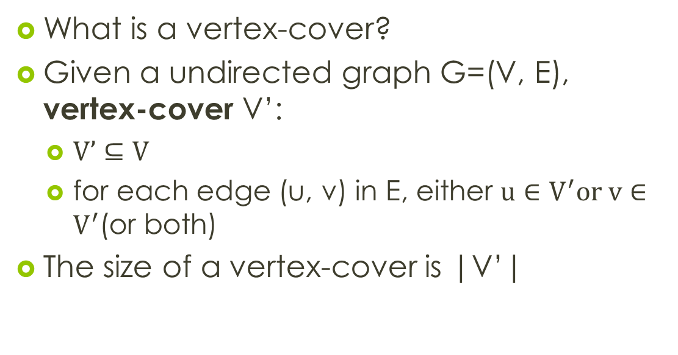
Vertex-cover problem and a 2-approximation algorithm
What is a vertex-cover?
Given a undirected graph G=(V, E), vertex-cover V’:
$V’⊆V$
for each edge (u, v) in E, either $u∈V^{′}or v∈V^{′}$(or both)
The size of a vertex-cover is |V’|

Slide 22
Vertex-cover problem and a 2-approximation algorithm
1
2
3
4
5
6
7
Are the black vertices a vertex-cover?
No. why?
Edges (5, 6), (3, 6) and (3, 7) are not covered by it

Slide 23
Vertex-cover problem and a 2-approximation algorithm
1
2
3
4
5
6
7
Are the black vertices a vertex-cover?
No. why?
Edge (3, 7) is not covered by it

Slide 24
Vertex-cover problem and a 2-approximation algorithm
1
2
3
4
5
6
7
Are the black vertices a vertex-cover?
Yes
What is the size?
4

Slide 25
Vertex-cover problem and a 2-approximation algorithm
1
2
3
4
5
6
7
Are the black vertices a vertex-cover?
Yes
What is the size?
7

Slide 26
Vertex-cover problem and a 2-approximation algorithm
1
2
3
4
5
6
7
Are the black vertices a vertex-cover?
Yes
What is the size?
5

Slide 27
Vertex-cover problem and a 2-approximation algorithm
1
2
3
4
5
6
7
Are the black vertices a vertex-cover?
Yes
What is the size?
3

Slide 28
Vertex-cover problem and a 2-approximation algorithm
Vertex-cover problem
Given a undirected graph, find a vertex cover with minimum size.

Slide 29
Vertex-cover problem and a 2-approximation algorithm
1
2
3
4
5
6
7
A minimum vertex-cover

Slide 30
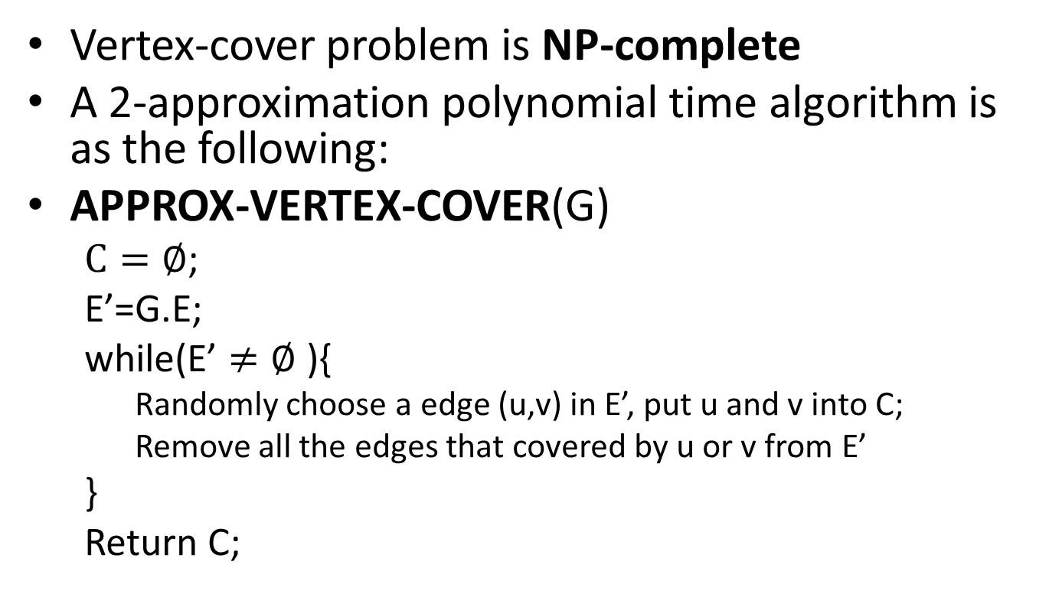
Vertex-cover problem and a 2-approximation algorithm
Vertex-cover problem is NP-complete
A 2-approximation polynomial time algorithm is as the following:
APPROX-VERTEX-COVER(G)
$C=∅$;
E’=G.E;
while(E’ $≠∅$ ){
Randomly choose a edge (u,v) in E’, put u and v into C;
Remove all the edges that covered by u or v from E’
}
Return C;

Slide 31
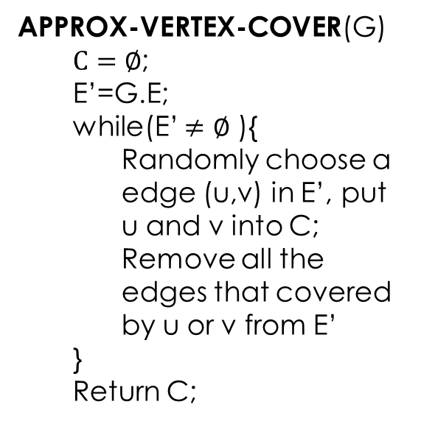
Vertex-cover problem and a 2-approximation algorithm
APPROX-VERTEX-COVER(G)
$C=∅$;
E’=G.E;
while(E’ $≠∅$ ){
Randomly choose a edge (u,v) in E’, put u and v into C;
Remove all the edges that covered by u or v from E’
}
Return C;
1
2
3
4
5
6
7

Slide 32
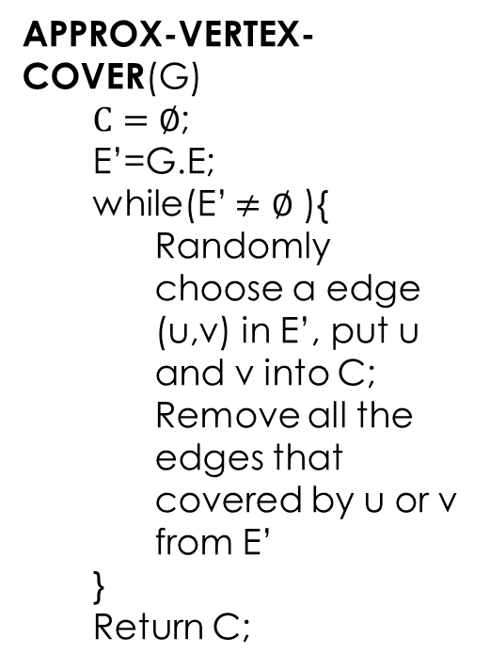
Vertex-cover problem and a 2-approximation algorithm
APPROX-VERTEX-COVER(G)
$C=∅$;
E’=G.E;
while(E’ $≠∅$ ){
Randomly choose a edge (u,v) in E’, put u and v into C;
Remove all the edges that covered by u or v from E’
}
Return C;
1
2
3
4
5
6
7
It is then a vertex cover
Size?
6
Max(6/3, 3/6) = 2
How far from optimal one?

Slide 33
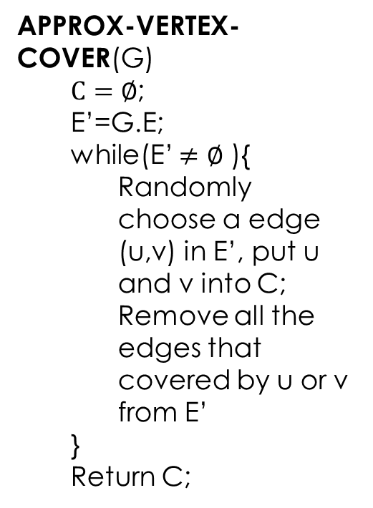
Vertex-cover problem and a 2-approximation algorithm
APPROX-VERTEX-COVER(G)
$C=∅$;
E’=G.E;
while(E’ $≠∅$ ){
Randomly choose a edge (u,v) in E’, put u and v into C;
Remove all the edges that covered by u or v from E’
}
Return C;
1
2
3
4
5
6
7

Slide 34
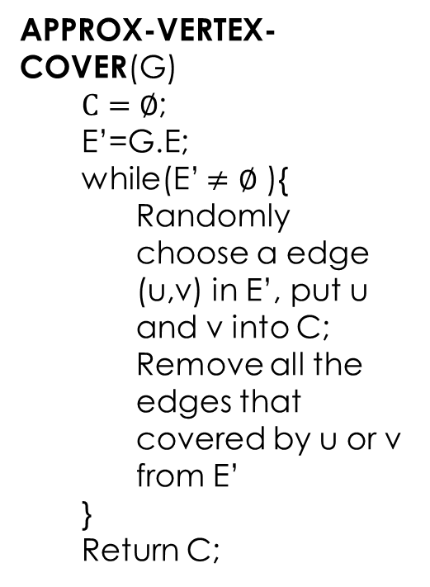
Vertex-cover problem and a 2-approximation algorithm
APPROX-VERTEX-COVER(G)
$C=∅$;
E’=G.E;
while(E’ $≠∅$ ){
Randomly choose a edge (u,v) in E’, put u and v into C;
Remove all the edges that covered by u or v from E’
}
Return C;
1
2
3
4
5
6
7
It is then a vertex cover
Size?
4
How far from optimal one?
Max(4/3, 3/4) = 1.33

Slide 35
Vertex-cover problem and a 2-approximation algorithm
APPROX-VERTEX-COVER(G) is a 2-approximation algorithm
When the size of minimum vertex-cover is s
The vertex-cover produced by APPROX-VERTEX-COVER is at most 2s

Slide 36
NP Hard problems

Slide 37
To prove a problem is NP Hard
Pick a problem P1 which is already in NP Hard.
Obtain an instance( in polynomial time) I` of P2 from any instance I of P1.
I` should determine the solution of I from P1.
From step 1 and 2 conclude that P1 P2.
From above steps conclude that P2 is NP Hard

Slide 38
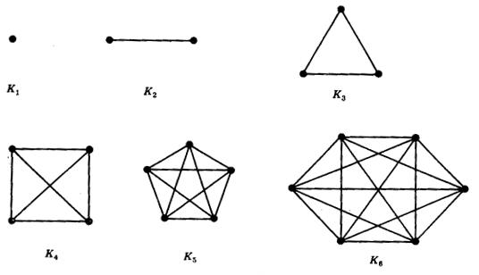
Clique Decision problem
Clique is a sub graph which is a complete graph
Complete graph: a graph with n vertices and an edge between every two edges.
There are no loops
Every two vertices share exactly one edge.
Finding the maximum clique is NP complete problem

Slide 39
Code generation problem
The code generation phase of compiler produces an optimal code if
The number of instructions are minimum.
The number of required registers are minimum.
Finding the minimum code or minimum number of registers required is NP Hard problem

Slide 40
Some other NP Hard problems
CNF satisfiability problem (conjunctive normal form) with 3 literals
Determining whether a planar graph is 3 colorable is NP Hard
Generating optimal code for given expression.
We can solve NP Hard problems if some restrictions are relaxed.

